Slide 1
Sources of Error
by
Dr. Md. Rajibul Islam
CSE, UAP

Slide 2
Sources of Error

Slide 3
Two sources of numerical error
Round off error
Truncation error

Slide 4
Round-off Error

Slide 5
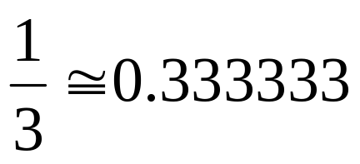
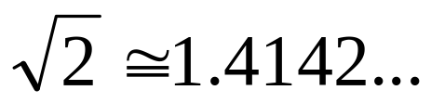
Round off Error
Errors created due to approximate representation of numbers

Slide 6
Effect of Carrying Significant
Digits in Calculations

Slide 7
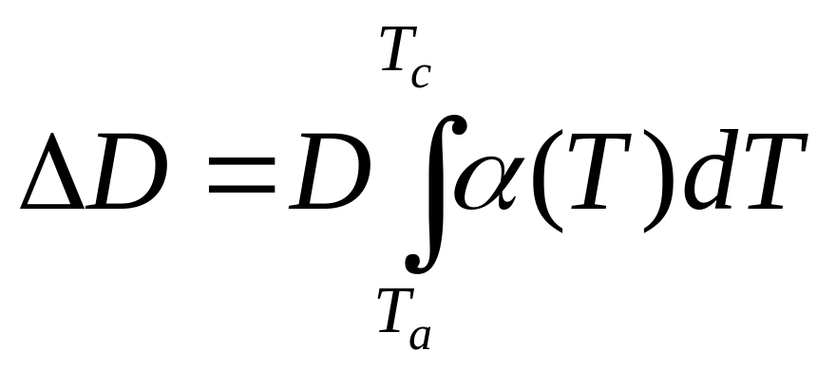
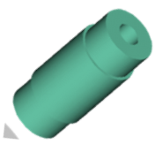
Find the contraction in the diameter
T_{a}=80ºF; T_{c}=-108ºF; D=12.363”
α = a₀+ a₁T + a₂T²

Slide 8
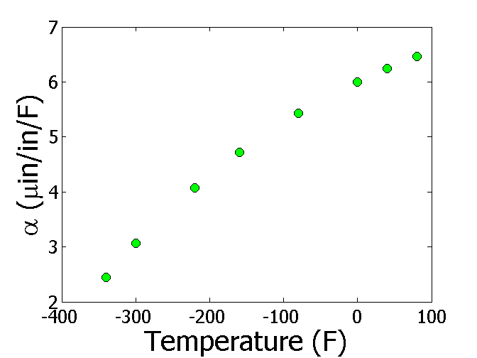

Thermal Expansion Coefficient vs Temperature
T(ºF) | α (μin/in/ºF)
-340 | 2.45
-300 | 3.07
-220 | 4.08
-160 | 4.72
-80 | 5.43
0 | 6.00
40 | 6.24
80 | 6.47

Slide 9
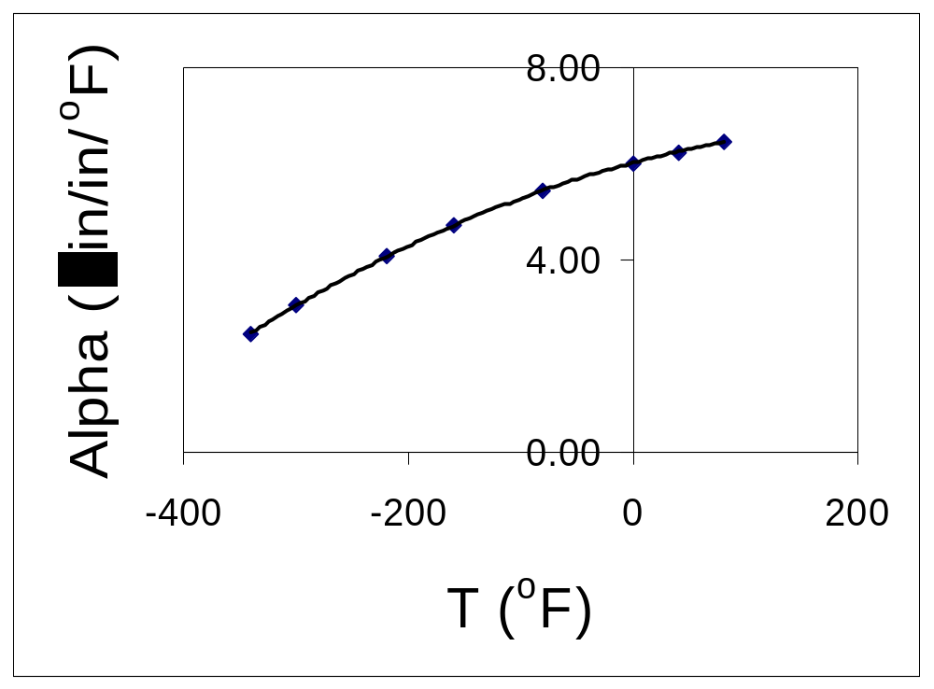
Regressing Data in Excel
(general format)
α = -1E-05T² + 0.0062T + 6.0234

Slide 10
Observed and Predicted Values
α = -1E-05T² + 0.0062T + 6.0234
T(ºF) | α (μin/in/ºF) Given | α (μin/in/ºF) Predicted
-340 | 2.45 | 2.76
-300 | 3.07 | 3.26
-220 | 4.08 | 4.18
-160 | 4.72 | 4.78
-80 | 5.43 | 5.46
0 | 6.00 | 6.02
40 | 6.24 | 6.26
80 | 6.47 | 6.46

Slide 11
Regressing Data in Excel
(scientific format)
α = -1.2360E-05T² + 6.2714E-03T + 6.0234

Slide 12
Observed and Predicted Values
α = -1.2360E-05T² + 6.2714E-03T + 6.0234
T(ºF) | α (μin/in/ºF) Given | α (μin/in/ºF) Predicted
-340 | 2.45 | 2.46
-300 | 3.07 | 3.03
-220 | 4.08 | 4.05
-160 | 4.72 | 4.70
-80 | 5.43 | 5.44
0 | 6.00 | 6.02
40 | 6.24 | 6.25
80 | 6.47 | 6.45

Slide 13
Observed and Predicted Values
α = -1.2360E-05T² + 6.2714E-03T + 6.0234
α = -1E-05T² + 0.0062T + 6.0234
T(ºF) | α (μin/in/ºF) Given | α (μin/in/ºF) Predicted | α (μin/in/ºF) Predicted
-340 | 2.45 | 2.46 | 2.76
-300 | 3.07 | 3.03 | 3.26
-220 | 4.08 | 4.05 | 4.18
-160 | 4.72 | 4.70 | 4.78
-80 | 5.43 | 5.44 | 5.46
0 | 6.00 | 6.02 | 6.02
40 | 6.24 | 6.25 | 6.26
80 | 6.47 | 6.45 | 6.46

Slide 14
Truncation Error

Slide 15
Truncation error
Error caused by truncating or approximating a mathematical procedure.

Slide 16

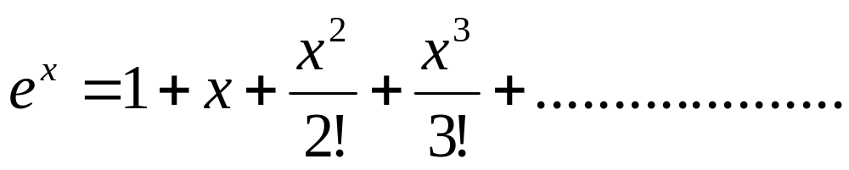
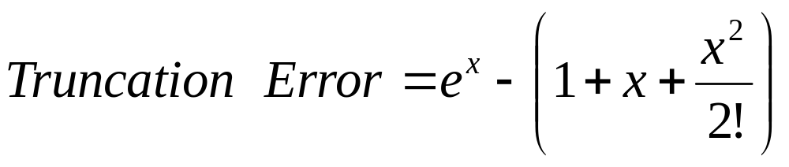
Example of Truncation Error
Taking only a few terms of a Maclaurin series to
approximate
If only 3 terms are used,

Slide 17

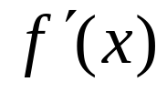
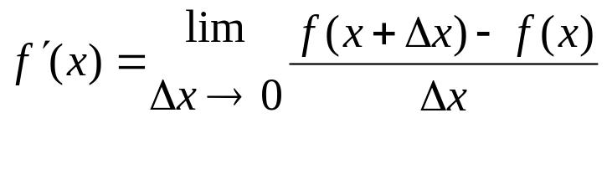
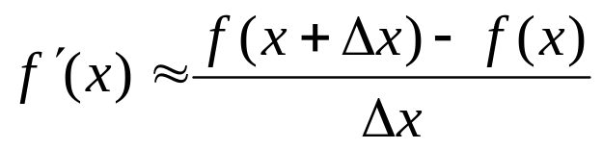
Another Example of Truncation Error
Using a finite
to approximate
secant line
tangent line
P
f(x+∆x)-f(x)
Q
∆x
x
∆x
Figure 1. Approximate derivative using finite Δx

Slide 18
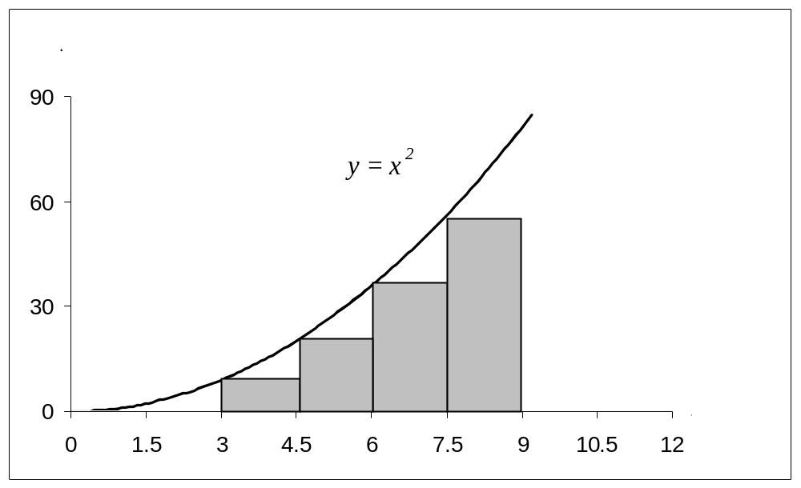
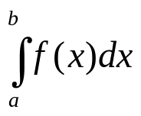
Another Example of Truncation Error
Using finite rectangles to approximate an integral.
f(x)
a
b
Need infinite number of rectangles
But to numerical solve this we want to use a finite number of rectangles
Truncation error occurs

Slide 19
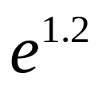
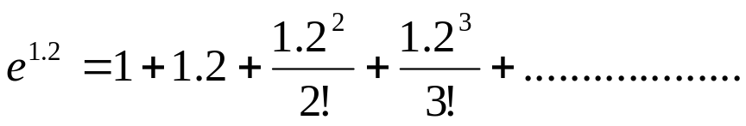

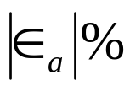
Example 1 —Maclaurin series
Calculate the value of
with an absolute
relative approximate error of less than 1%.
n
1 | 1 | __ | ___
2 | 2.2 | 1.2 | 54.545
3 | 2.92 | 0.72 | 24.658
4 | 3.208 | 0.288 | 8.9776
5 | 3.2944 | 0.0864 | 2.6226
6 | 3.3151 | 0.020736 | 0.62550
= Approximate error
= Relative approximate error
6 terms are required. How many are required to get at least 1 significant digit correct in your answer?

Slide 20



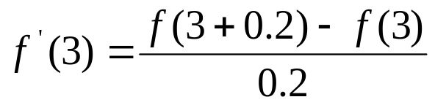
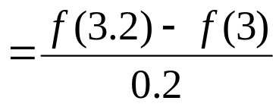
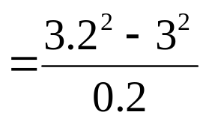
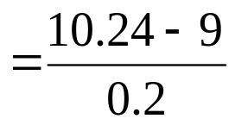
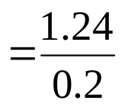




Example 2 —Differentiation
Find
for
using
and
The actual value is
Truncation error is then,

Slide 21
Additional Resources
Numerical Methods with Applications: Abridged (2nd Edition) – Autar Kaw, Egwu Kalu
  http://mathforcollege.com/nm/topics/textbook_index.html
Introductory Methods of Numerocal Analysis – S. S. Sastry

Slide 22
THE END

